Slide 1





DIGIMED
AI Driven Secure Health Data Management System for Sri Lanka.
R24-25J-119
06/08/2024
01

Slide 2








OUR TEAM
SUPERVISOR
CO-SUPERVISOR
Mr. Kanishka Yapa
Mr. Tharaniyawarma
Lecturer
Assistant Lecturer
Faculty of Computing
Faculty of Computing
Arachchi R.P.N
Pathiraja P.M.C.H.
Lansakara L.H.M.J.C.
Sandaruwan W.U.P
IT21182464
IT21352812
IT21171260
IT21157646
CYBER SECURITY
CYBER SECURITY
CYBER SECURIRTY
CYBER SECURITY
R24-25J-119
06/08/2024
02

Slide 3

INTRODUCTION
Traditional healthcare data management in Sri Lanka, burdened by manual processes, faces challenges such as data security vulnerabilities, fragmented patient records, and inefficiencies in data handling. These issues underscore the urgent need for a modern, more secure and robust approach to ensure data integrity, enhance patient care, and streamline healthcare operations.
R24-25J-119
06/08/2024
03

Slide 4

How can a secure, efficient, and scalable health data management system leveraging blockchain for data integrity and AI for enhanced data usability address challenges in data security, integrity, and management workload, thereby improving patient care and operational efficiency in healthcare organizations in Sri Lanka?
RESEARCH
QUESTION
R24-25J-119
06/08/2024
04

Slide 5


OBJECTIVES
DEVELOP A BLOCKCHAIN-BASED WALLET SYSTEM WITH ADVANCED AUTHENTICATION SYSTEM
DEVELOP A BLOCKCHAIN-BASED ZKP MODEL TO ENHANCE THE HEALTHCARE SECURITY
DEVELOP DDOS DETECTION SYSTEM FOR SAFEGUARDING AVAILABILITY AND INTEGRITY OF HEALTH DATA SERVICES.
DEVELOP XXS DETECTION SYSTEM FOR SAFEGUARDING THE SECURITY AND INTEGRITY OF HEALTH DATA SERVICES
R24-25J-119
06/08/2024
05

Slide 6













OVERALL SYSTEM DIAGRAM
DATA INPUT LAYER
BLOCKCHAIN-BASED DATABASE
BLOCKCHAIN - BASED ADVANCED AUTHENTICATION SYSTEM
SECRE WALLET SYSTEM
ZKP AND ZK-ROLLUPS
DATA VALIDATION
DDOS DETECTION SYSTEM
XSS DETECTION SYSTEM
REAL-TIME DDOS ALERTS
DIGIMED WEBSITE
REAL-TIME XSS ALERTS
R24-25J-119
05/08/2024
06

Slide 7

JANESHA LANSAKARA
IT21171260
LANSAKARA L.H.M.J.C.
SPECIALIZATION : CYBER SECURITY
DEVELOP A BLOCKCHAIN-BASED WALLET SYSTEM WITH ADVANCED AUTHENTICATION SYSTEM
LANSAKARA L.H.M.J.C.
IT21171260
R24-25J-119
05/08/2024
08

Slide 8



BACKGROUND
WHAT IS BLOCKCHAIN-BASED ADVANCED AUTHENTICATION SYSTEM?
A blockchain-based advanced authentication system leverages blockchain technology to enhance security and transparency in digital interactions. It uses decentralized and immutable ledgers to store and verify authentication data.
IMPORTANCE OF BLOCKCHAIN TO HANDLE HEALTH DATA
Security
Transparency
Interoperability
Patient Trust
IT21015526
IT21015526
LANSAKARA L.H.M.J.C.
IT21171260
KUMARASIRI M.A.K.P
KUMARASIRI M.A.K.P
R24-004
R24-004
R24-25J-119
02/21/2024
05/08/2024
11
02/21/2024
09
09

Slide 9

RESEARCH QUESTION​
​
HOW CAN A BLOCKCHAIN-BASED ADVANCED AUTHENTICATION SYSTEM BE DEVELOPED TO IMPROVE THE SECURITY, EFFICIENCY, AND SCALABILITY OF TRADITIONAL HEALTH DATA MANAGEMENT IN SRI LANKA’S HEALTHCARE SECTOR?
IT21015526
LANSAKARA L.H.M.J.C.
IT21171260
KUMARASIRI M.A.K.P
R24-004
R24-25J-119
02/21/2024
05/08/2024
10
9

Slide 10


RESEARCH GAP
Application References | Blockchain Based Secure route system | Secure wallet system using Metamask | Biometric authentication system | Unique JSON Web Tokens (JWT) Generation
Research A
Research B
Research C
DIGIMED
IT21015526
LANSAKARA L.H.M.J.C.
IT21171260
KUMARASIRI M.A.K.P
R24-004
R24-25J-119
02/21/2024
05/08/2024
11
10

Slide 11

SPECIFIC AND SUB OBJECTIVES​
​
DESIGN A BLOCKCHAIN-BASED ADVANCED AUTHENTICATION WALLET SYSTEM USING METAMASK WITH SECURE ROUTE SYSTEM, INTEGRATING UNIQUE TOKEN SYSTEMS WITH ADVANCED AUTHENTICATION TECHNOLOGIES
Design and Implement a Blockchain-Based Advanced Authentication Wallet System Using MetaMask
Design and Develop a Multifactor Authentication System, Including Biometrics and 2FA
Create a Unique Token System (JWT) for Access Management, Permission Granting, and Transaction Tracking
Integrate the Wallet Interface and Token System with the Database and Blockchain System
Implement Security Measures to Ensure the Security of the Wallet Interface
IT21015526
IT21015526
LANSAKARA L.H.M.J.C.
IT21171260
KUMARASIRI M.A.K.P
KUMARASIRI M.A.K.P
R24-004
R24-004
R24-25J-119
02/21/2024
05/08/2024
11
02/21/2024
11
12

Slide 12
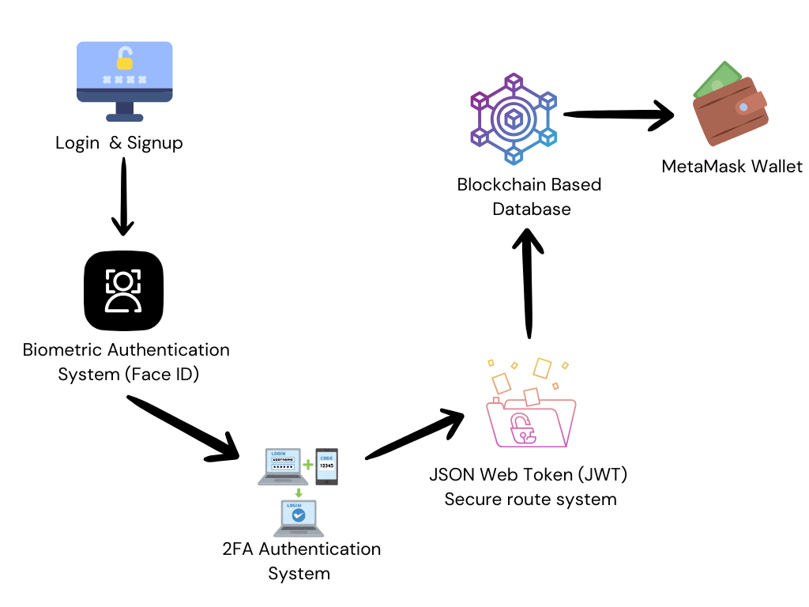

COMPONENT DIAGRAM
PARALLEL PROCESS
IT21015526
IT21015526
LANSAKARA L.H.M.J.C.
IT21171260
KUMARASIRI M.A.K.P
KUMARASIRI M.A.K.P
R24-004
R24-004
R24-25J-119
02/21/2024
02/21/2024
05/08/2024
14
11
14

Slide 13

METHODOLOGY
DESIGN AND DEVELOP 2FA AND BIOMETRIC AUTHENTICATION SYSTEM:
DESIGN AND IMPLEMENT A MULTIFACTOR AUTHENTICATION SYSTEM COMBINING 2FA (E.G., SMS, EMAIL) AND BIOMETRICS.
DESIGN USER-FRIENDLY WALLET INTERFACE USING METAMASK:
CREATE AN INTUITIVE INTERFACE FOR MANAGING TOKENS AND AUTHENTICATION, INTEGRATING WITH METAMASK TO HANDLE SECURE TRANSACTIONS.
CREATE UNIQUE TOKEN SYSTEM (JWT):
DEVELOP A JWT-BASED SYSTEM FOR SECURE USER CREDENTIAL TRANSMISSION, ENSURING ENCRYPTION AND TOKEN VALIDATION FOR SECURE ACCESS.
IMPLEMENT SECURITY MEASURES:
ENCRYPT DATA BOTH AT REST AND IN TRANSIT TO PROTECT SENSITIVE INFORMATION.
CONDUCT VULNERABILITY SCANNING AND PENETRATION TESTING TO IDENTIFY AND MITIGATE SECURITY RISKS CONTINUOUSLY.
IT21015526
IT21015526
LANSAKARA L.H.M.J.C.
IT21171260
KUMARASIRI M.A.K.P
KUMARASIRI M.A.K.P
R24-004
R24-004
R24-25J-119
02/21/2024
05/08/2024
11
02/21/2024
13
13

Slide 14











TOOLS & TECHNOLOGIES
WEB3.JS
METAMASK
VS CODE
ETHERIUM
2FA
DOCKER
JWT
BIOMETRICS
NODE.JS
EXPRESS.JS
R24-25J-119
IT21015526
LANSAKARA L.H.M.J.C.
IT21171260
KUMARASIRI M.A.K.P
R24-004
R24-25J-119
02/21/2024
05/08/2024
11
05/08/2024
13
07

Slide 15








COMPLETION OF THE PROJECT
WE ARE
HERE
Unique JWT Token System Development
Full Deployment and Evaluation
Data Collection
2024
June
2025
May
Project Planning and Preliminary Research
Develop Blockchain-based authentication System
Integrate wallet with Token system and blockchain
Project Review and Future Planning
IT21015526
IT21015526
LANSAKARA L.H.M.J.C.
IT21171260
KUMARASIRI M.A.K.P
KUMARASIRI M.A.K.P
R24-004
R24-004
R24-25J-119
02/21/2024
02/21/2024
05/08/2024
17
11
17

Slide 16
REQUIREMENTS
USER
FUNCTIONAL
Secure access to health data.
User-friendly interface for healthcare professionals.
Reliable authentication processes.
Transparent transaction logs.
Compliance with local and international data privacy regulations.
Integration of blockchain technology for data integrity.
Implementation of multifactor authentication (2FA and biometrics).
Use of MetaMask for managing access tokens.
JWT (JSON Web Tokens) for secure credential transmission.
System integration with existing healthcare databases and infrastructure.
IT21015526
IT21015526
LANSAKARA L.H.M.J.C.
IT21171260
KUMARASIRI M.A.K.P
KUMARASIRI M.A.K.P
R24-004
R24-004
R24-25J-119
02/21/2024
02/21/2024
05/08/2024
15
11
15

Slide 17
WORK BREAKDOWN CHART
Blockchain-Based Wallet using Metamask
Background Study
Requirements
Documentation
Design
Implement
Testing
Requirements Gathering
TAF Documentation
2FA Design
Develop 2FA System
Topic Selection
Unit Testing
Feasibility Study
Proposal Presenatation
JWT Web Token System Design
Develop Wallet System
System Testing
Requirements Analysis
Literature Survey
Secure wallet system using metamask
Develop JWT Token System
Integration Testing
Requirements Specification
Proposal Report
Progress Report
Integration wallet with the biometrics and 2FA and JWT token system
Final Report
Implement Security Measures
IT21015526
IT21015526
LANSAKARA L.H.M.J.C.
IT21171260
KUMARASIRI M.A.K.P
KUMARASIRI M.A.K.P
R24-004
R24-004
R24-25J-119
02/21/2024
02/21/2024
05/08/2024
16
11
16

Slide 18
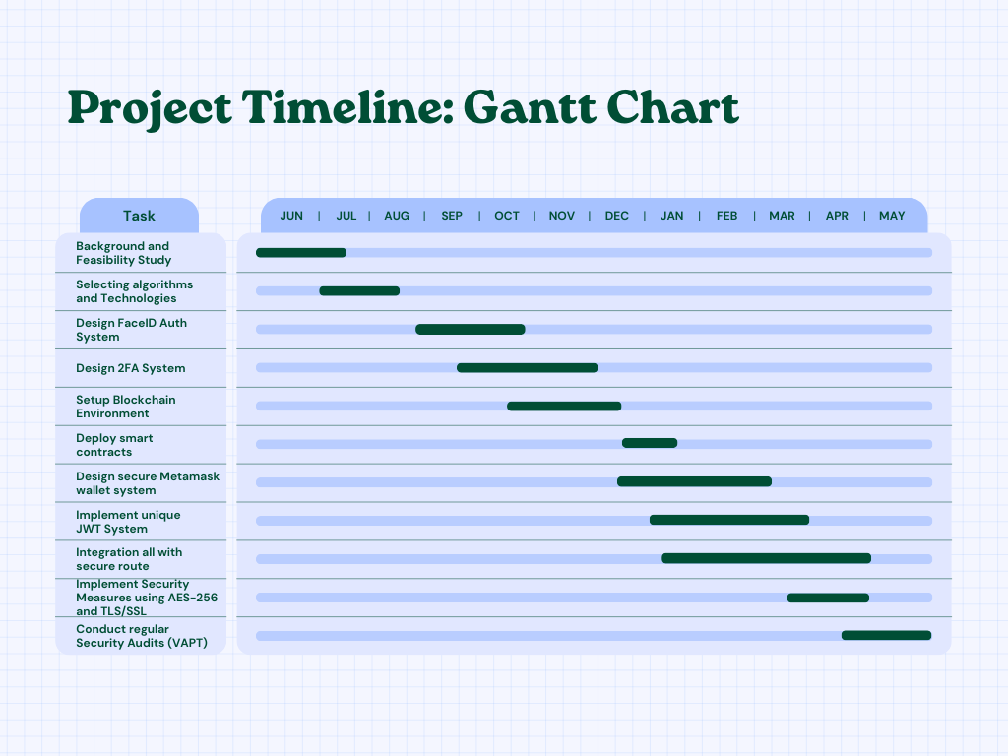
IT21015526
LANSAKARA L.H.M.J.C.
IT21171260
KUMARASIRI M.A.K.P
R24-004
R24-25J-119
02/21/2024
05/08/2024
11
16

Slide 19

REFERENCES
[1] MOSTAFA, AYMAN & EZZ, MOHAMED & ELBASHIR, MURTADA & ALRUILY, MESHRIF & HAMOUDA, ESLAM & ALSARHANI, MOHAMED & SAID, WAEL. (2023). STRENGTHENING CLOUD SECURITY: AN INNOVATIVE MULTI-FACTOR MULTI-LAYER AUTHENTICATION FRAMEWORK FOR CLOUD USER AUTHENTICATION. APPLIED SCIENCES. 13. 10871. 10.3390/APP131910871.
[2] METTLER, MATTHIAS. (2016). BLOCKCHAIN TECHNOLOGY IN HEALTHCARE: THE REVOLUTION STARTS HERE. 1-3. 10.1109/HEALTHCOM.2016.7749510.
[3]ANYANWU, ANTHONY & OLORUNSOGO, TEMIDAYO & ABRAHAMS, TEMITAYO & AKINDOTE, ODUNAYO & REIS, OLUWATOSIN. (2024). DATA CONFIDENTIALITY AND INTEGRITY: A REVIEW OF ACCOUNTING AND CYBERSECURITY CONTROLS IN SUPERANNUATION ORGANIZATIONS. COMPUTER SCIENCE & IT RESEARCH JOURNAL. 5. 237-253. 10.51594/CSITRJ.V5I1.735.
IT21015526
IT21015526
LANSAKARA L.H.M.J.C.
IT21171260
KUMARASIRI M.A.K.P
KUMARASIRI M.A.K.P
R24-004
R24-004
R24-25J-119
02/21/2024
05/08/2024
11
02/21/2024
18
18

Slide 20
RAVINDU PAHASARA
IT21182464
ARACHCHI R.P.N
SPECIALIZATION : CYBER SECURITY
DEVELOP DDOS DETECTION SYSTEM FOR SAFEGUARDING AVAILABILITY AND INTEGRITY OF HEALTH DATA SERVICES
ARACHCHI R.P.N
IT21182464
R24-25J-119
06/08/2024
30

Slide 21

BACKGROUND
WHAT IS A DDOS IDENTIFICATION MACHINE LEARNING MODEL?
A DDoS (Distributed Denial of Service) identification machine learning model is an AI-based system designed to detect DDoS attacks. These attacks aim to overwhelm a network or service with traffic, rendering it unavailable to legitimate users
IMPORTANCE OF IDENTIFYING DDOS ATTACKS IN HEALTH DATA MANAGEMENT SYSTEMS
Availability
Data Integrity
Patient Safety
Regulatory Compliance
Operational Efficiency
ARACHCHI R.P.N
IT21182464
R24-25J-119
IT21015526
IT21015526
LANSAKARA L.H.M.J.C.
IT21171260
05/08/2024
31
KUMARASIRI M.A.K.P
KUMARASIRI M.A.K.P
R24-004
R24-004
R24-25J-119
02/21/2024
05/08/2024
11
02/21/2024
31
09

Slide 22
RESEARCH QUESTION​
​
HOW CAN IMPLEMENTING A MACHINE LEARNING-BASED DDOS DETECTION SYSTEM IN HEALTH DATA MANAGEMENT IMPROVE THE SECURITY AND AVAILABILITY OF HEALTH SERVICES BY PROVIDING IN-DEPTH NETWORK TRAFFIC ANALYSIS AND REAL-TIME NOTIFICATIONS TO PRECISELY IDENTIFY AND MITIGATE DDOS ATTACKS?
ARACHCHI R.P.N
IT21182464
R24-25J-119
IT21015526
LANSAKARA L.H.M.J.C.
IT21171260
05/08/2024
32
KUMARASIRI M.A.K.P
R24-004
R24-25J-119
02/21/2024
05/08/2024
10
32

Slide 23
RESEARCH GAP
Application References | Deep Learning Model Implementation | Real-Time Analysis | Quickly Adaptive and Learning | Specialization for Health Data Management
Research 1
Research 2
Research 3
DIGIMED
ARACHCHI R.P.N
IT21182464
R24-25J-119
IT21015526
LANSAKARA L.H.M.J.C.
IT21171260
05/08/2024
33
KUMARASIRI M.A.K.P
R24-004
R24-25J-119
02/21/2024
05/08/2024
11
33

Slide 24
SPECIFIC AND SUB OBJECTIVES​
​
DEVELOP A DDOS DETECTION SYSTEM FOR HEALTH DATA MANAGEMENT THAT IS BASED ON MACHINE LEARNING. IT WILL GIVE ADMINISTRATORS ACCESS TO IN-DEPTH NETWORK TRAFFIC ANALYSIS AND REAL-TIME NOTIFICATIONS TO PRECISELY IDENTIFY DDOS ATTACKS, SAFEGUARDING THE AVAILABILITY AND INTEGRITY OF HEALTH DATA SERVICES.
Identify Key Features for DDoS Detection
Develop and Train a Machine Learning Model
Integrate the Detection System with Health Data Management Infrastructure
Implement Real-Time Monitoring and Alert Mechanism
Evaluate and Optimize System Performance
ARACHCHI R.P.N
IT21182464
R24-25J-119
IT21015526
IT21015526
LANSAKARA L.H.M.J.C.
IT21171260
05/08/2024
34
KUMARASIRI M.A.K.P
KUMARASIRI M.A.K.P
R24-004
R24-004
R24-25J-119
02/21/2024
05/08/2024
11
02/21/2024
34
12

Slide 25
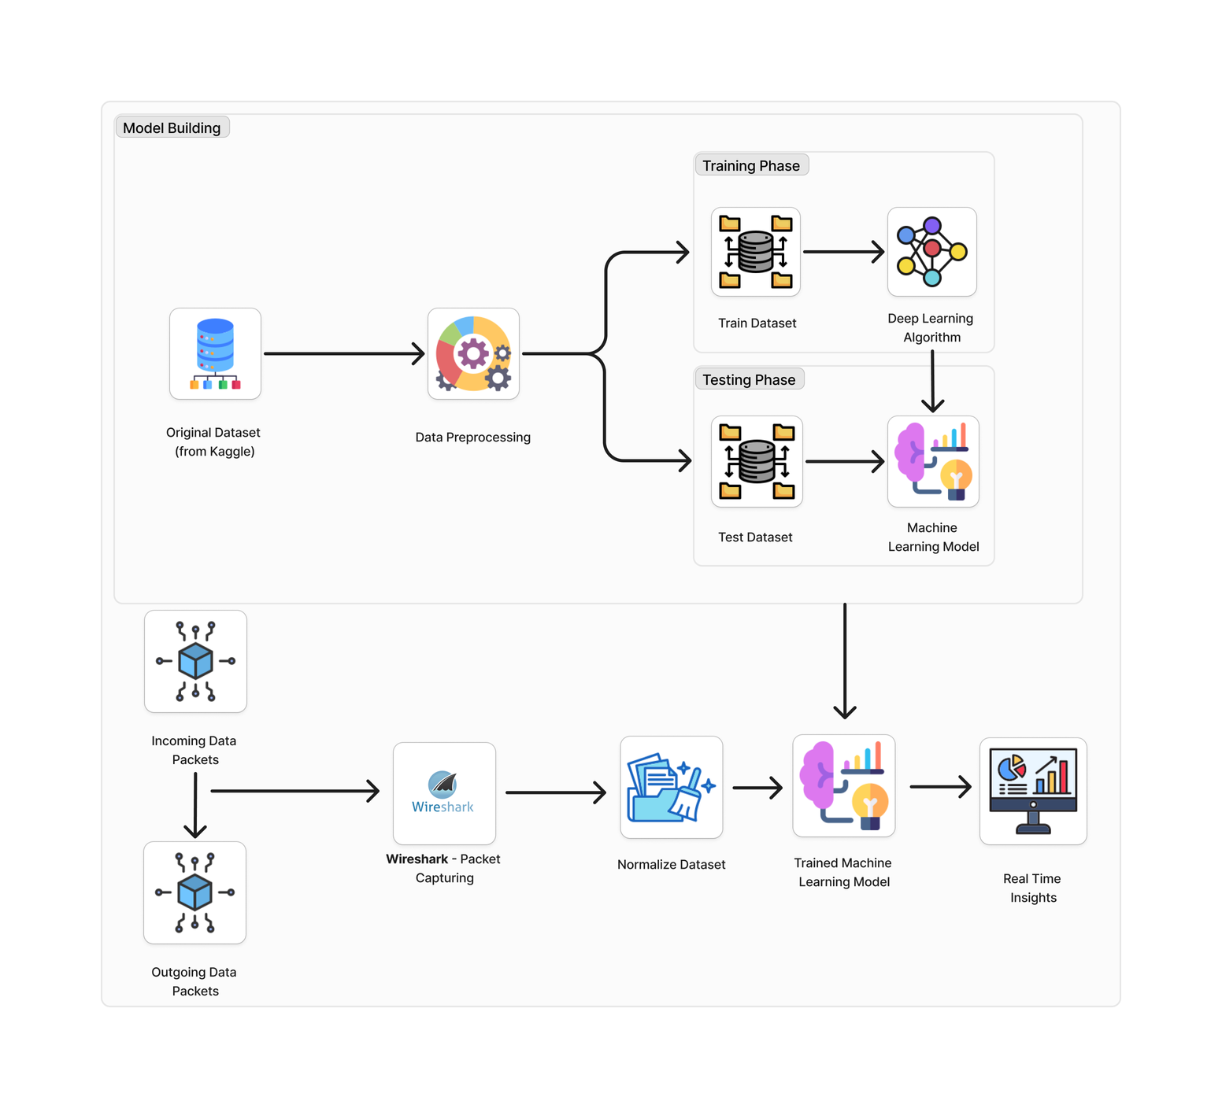
COMPONENT DIAGRAM
ARACHCHI R.P.N
IT21182464
R24-25J-119
IT21015526
IT21015526
LANSAKARA L.H.M.J.C.
IT21171260
05/08/2024
36
KUMARASIRI M.A.K.P
KUMARASIRI M.A.K.P
R24-004
R24-004
R24-25J-119
02/21/2024
02/21/2024
05/08/2024
14
11
36

Slide 26
METHODOLOGY
DATA COLLECTION:
REVIEW OF CURRENT DDOS DETECTION METHODS AND THEIR LIMITATIONS.
DESCRIPTION OF DATASETS USED FOR MODEL TRAINING AND VALIDATION.
FEATURE ENGINEERING:
PROCESS OF SELECTING AND EXTRACTING RELEVANT FEATURES FROM NETWORK TRAFFIC.
MODEL SELECTION:
CRITERIA FOR CHOOSING THE MACHINE LEARNING ALGORITHM.
MODEL TRAINING AND VALIDATION:
DEPLOY THE MODEL IN A CONTROLLED ENVIRONMENT.
STEPS INVOLVED IN TRAINING THE MODEL AND VALIDATING ITS ACCURACY.
INTEGRATION AND REAL-TIME ANALYSIS:
INTEGRATE THE MODEL WITH SECURE HEALTH DATA MANAGEMENT SYSTEM FOR REAL-TIME MONITORING AND ANALYTICS.
USE TECHNIQUES FOR MONITORING AND ANALYZING LIVE TRAFFIC.
IT21015526
IT21015526
IT21171260
LANSAKARA L.H.M.J.C.
IT21182464
ARACHCHI R.P.N
KUMARASIRI M.A.K.P
KUMARASIRI M.A.K.P
R24-004
R24-004
R24-25J-119
R24-25J-119
02/21/2024
05/08/2024
05/08/2024
11
35
02/21/2024
35
13

Slide 27










TOOLS & TECHNOLOGIES
WIRESHARK
TENSORFLOW
PYCHARM
SCIKIT-LEARN
PYTHON
MATPLOTLIB
MYSQL
JUPYTOR
GITHUB
PYTORCH
R24-25J-119
ARACHCHI R.P.N
IT21182464
R24-25J-119
05/08/2024
35
05/08/2024
07

Slide 28
COMPLETION OF THE PROJECT
WE ARE
HERE
Dashboard Development and Integration
Full Deployment and Evaluation
Data Collection
2024
June
2025
May
Project Planning and Preliminary Research
Model Development and Training
Pilot Testing and Refinement
Project Review and Future Planning
IT21352812
PATHIRAJA P.M.C.H.
IT21182464
ARACHCHI R.P.N
R24-25J-119
IT21015526
R24-25J-119
IT21015526
IT21171260
05/08/2024
05/08/2024
39
LANSAKARA L.H.M.J.C.
39
KUMARASIRI M.A.K.P
KUMARASIRI M.A.K.P
R24-004
R24-004
R24-25J-119
02/21/2024
02/21/2024
05/08/2024
17
11
17

Slide 29
REQUIREMENTS
USER
FUNCTIONAL
Real-time Alerts for suspected DDoS attacks.
User-friendly
Seamless Integration with existing health data management systems.
Traffic Analysis reports
Ensure minimal False positives and negatives in detection
Continuously monitor network traffic
Classify traffic using the trained ML model
Time-Stamped Event Logging
Real-Time notifications
Integration with Existing Systems
Allow manual intervention and override of automatic actions
ARACHCHI R.P.N
IT21182464
R24-25J-119
IT21015526
IT21015526
LANSAKARA L.H.M.J.C.
IT21171260
05/08/2024
40
KUMARASIRI M.A.K.P
KUMARASIRI M.A.K.P
R24-004
R24-004
R24-25J-119
02/21/2024
02/21/2024
05/08/2024
15
11
37

Slide 30
WORK BREAKDOWN CHART
DDoS Detection System
Background Study
Requirements
Documentation
Design
Implement
Testing
Topic Selection
Requirements Gathering
TAF Documentation
Wireframe Design
Data Preprocessing
Unit Testing
Feasibility Study
Requirements Analysis
Proposal Presentation
Database Design
Feature Engineering
System Testing
Literature Survey
Dashboard Design
Model Selection
Integration Testing
Requirements Specification
Proposal Report
Model Training &
Evaluation
Progress Report
Model Refinement & Deployment
Final Report
Integration with
Dashboard
IT21352812
PATHIRAJA P.M.C.H.
IT21182464
ARACHCHI R.P.N
R24-25J-119
IT21015526
R24-25J-119
IT21015526
IT21171260
05/08/2024
05/08/2024
38
LANSAKARA L.H.M.J.C.
41
KUMARASIRI M.A.K.P
KUMARASIRI M.A.K.P
R24-004
R24-004
R24-25J-119
02/21/2024
02/21/2024
05/08/2024
16
11
16

Slide 31
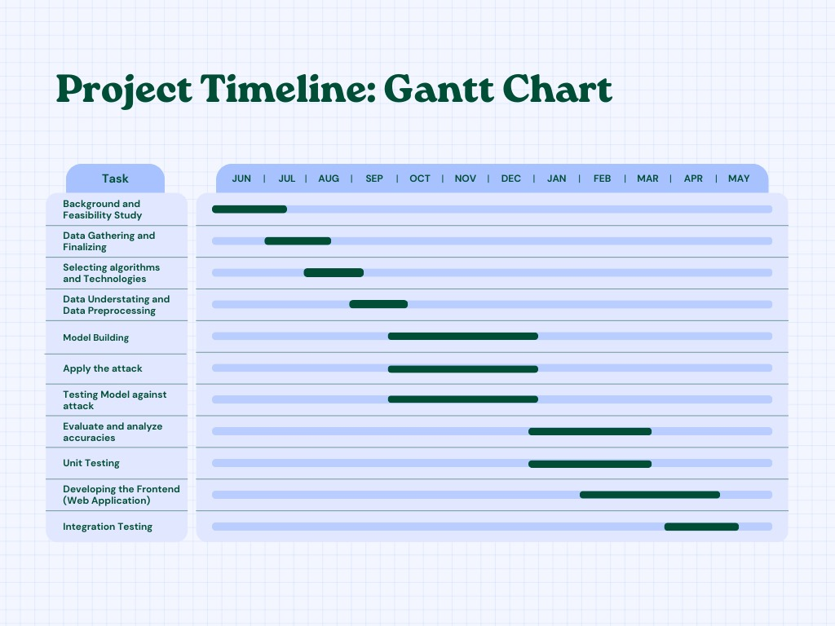
IT21015526
LANSAKARA L.H.M.J.C.
IT21171260
KUMARASIRI M.A.K.P
R24-004
R24-25J-119
02/21/2024
05/08/2024
11
IT21352812
16
PATHIRAJA P.M.C.H.
IT21182464
ARACHCHI R.P.N
R24-25J-119
IT21015526
R24-25J-119
IT21015526
IT21171260
05/08/2024
05/08/2024
38
LANSAKARA L.H.M.J.C.
41
KUMARASIRI M.A.K.P
KUMARASIRI M.A.K.P
R24-004
R24-004
R24-25J-119
02/21/2024
02/21/2024
05/08/2024
16
11
PATHIRAJA P.M.C.H.
IT21352812
R24-25J-119
16
IT21015526
IT21015526
LANSAKARA L.H.M.J.C.
IT21171260
05/08/2024
27
KUMARASIRI M.A.K.P
KUMARASIRI M.A.K.P
R24-004
R24-004
R24-25J-119
02/21/2024
02/21/2024
05/08/2024
16
11
16

Slide 32
REFERENCES
[1] AHUJA, NISHA & MUKHOPADHYAY, DEBAJYOTI & SINGAL, GAURAV. (2024). DDOS ATTACK TRAFFIC CLASSIFICATION IN SDN USING DEEP LEARNING. PERSONAL AND UBIQUITOUS COMPUTING. 28. 1-13. 10.1007/S00779-023-01785-2.
[2] MANTE, JYOTI & PATIL, PRERNA & DHOTAY, MEGHA & BUDHAVALE, SHILPA. (2024). A HYBRID ENSEMBLE MACHINE LEARNING APPROACH (EHML) FOR DDOS ATTACK DETECTION IN SMART CITY NETWORK TRAFFIC. 10.1007/978-981-99-6984-5_4.
[3] ALJEBREEN, MOHAMMED & MENGASH, HANAN & ARASI, MUNYA & ALJAMEEL, SUMAYH & SALAMA, ENG. AHMED & HAMZA, MANAR. (2023). ENHANCING DDOS ATTACK DETECTION USING SNAKE OPTIMIZER WITH ENSEMBLE LEARNING ON INTERNET OF THINGS ENVIRONMENT. IEEE ACCESS. PP. 1-1. 10.1109/ACCESS.2023.3318316.
IT21352812
PATHIRAJA P.M.C.H.
IT21182464
ARACHCHI R.P.N
R24-25J-119
IT21015526
R24-25J-119
IT21015526
IT21171260
05/08/2024
05/08/2024
40
LANSAKARA L.H.M.J.C.
40
KUMARASIRI M.A.K.P
KUMARASIRI M.A.K.P
R24-004
R24-004
R24-25J-119
02/21/2024
05/08/2024
11
02/21/2024
18
18

Slide 33
CHAMIKA HIRUNI
IT21352812
PATHIRAJA P.M.C.H.
SPECIALIZATION : CYBER SECURITY
DEVELOP A BLOCKCHAIN-BASED ZKP MODEL TO ENHANCE THE HEALTHCARE SECURITY
PATHIRAJA P.M.C.H.
IT21352812
R24-25J-119
05/08/2024
19

Slide 34

BACKGROUND
WHAT IS ZERO-KNOWLEDGE PROOFS(ZKP)?
A cryptographic method that allows a user to prove their identity without disclosing confidential information, enhancing security by ensuring sensitive data is only shared with authorized parties.
IMPORTANCE OF USING BZKP MODEL TO HANDLE HEALTH DATA
Enhanced Data Integrity
Increased Security.
Improved Data Privacy.
Scalability and Efficiency.
IT21015526
IT21015526
PATHIRAJA P.M.C.H.
IT21352812
KUMARASIRI M.A.K.P
KUMARASIRI M.A.K.P
R24-004
R24-004
R24-25J-119
02/21/2024
02/21/2024
05/08/2024
09
11
20

Slide 35
RESEARCH QUESTION​
​
HOW CAN REPLACING TRADITIONAL DATABASES IN THE HEALTHCARE INSTITUTES WITH A BLOCKCHAIN-BASED SYSTEM, INCORPORATING ZERO-KNOWLEDGE PROOFS (ZKP) AND ZK-ROLLUPS, IMPROVE THE MANAGEMENT OF SENSITIVE HEALTHCARE DATA BY ENHANCING SECURITY, ENSURING PRIVACY, AND INCREASING OPERATIONAL EFFICIENCY?
IT21015526
IT21171260
IT21015526
IT21171260
IT21015526
IT21015526
LANSAKARA L.H.M.J.C.
IT21352812
KUMARASIRI M.A.K.P
LANSAKARA L.H.M.J.C.
PATHIRAJA P.M.C.H.
KUMARASIRI M.A.K.P
KUMARASIRI M.A.K.P
KUMARASIRI M.A.K.P
R24-004
R24-25J-119
R24-004
R24-004
R24-25J-119
R24-004
R24-25J-119
02/21/2024
05/08/2024
02/21/2024
02/21/2024
05/08/2024
02/21/2024
05/08/2024
11
11
09
11
21
10
10

Slide 36
RESEARCH GAP
Application References | Blockchain-based Database | Boosted Transaction Speed and Scalability | ZKP Model for Data Validation and Privacy Preserving | Reduce Gas Fees required for Transactions
Research 1
Research 2
Research 3
DIGIMED
IT21015526
IT21171260
IT21015526
IT21015526
LANSAKARA L.H.M.J.C.
IT21352812
PATHIRAJA P.M.C.H.
KUMARASIRI M.A.K.P
KUMARASIRI M.A.K.P
KUMARASIRI M.A.K.P
R24-004
R24-25J-119
R24-004
R24-004
R24-25J-119
02/21/2024
05/08/2024
02/21/2024
02/21/2024
05/08/2024
11
11
09
11
22

Slide 37
SPECIFIC AND SUB OBJECTIVES​
​
DESIGN A BLOCKCHAIN-BASED ZKP MODEL FOR SECURE HEALTH DATA MANAGEMENT BY OPTIMIZING THE GASS FEES AND ENHANCING THE SCALABILITY ANF TRANSACTION SPEED OF THE SYSTEM
Design and implement a blockchain architecture tailored for healthcare data management.
Develop the smart contracts using Solidity programming language.
Design and Integrate zero-knowledge proofs (ZKP) algorithms to ensure data privacy and non-repudiation.
Develop ZK-Rollups to aggregate transactions, reducing gas fees and improving scalability.
Integrate the Blockchain system, ZKP and ZK-Rollups with the MongoDB Database for efficient data storage and management.
IT21015526
IT21015526
IT21171260
IT21015526
IT21171260
IT21015526
IT21015526
LANSAKARA L.H.M.J.C.
IT21352812
LANSAKARA L.H.M.J.C.
PATHIRAJA P.M.C.H.
KUMARASIRI M.A.K.P
KUMARASIRI M.A.K.P
KUMARASIRI M.A.K.P
KUMARASIRI M.A.K.P
KUMARASIRI M.A.K.P
R24-004
R24-004
R24-25J-119
R24-004
R24-25J-119
R24-004
R24-004
R24-25J-119
02/21/2024
05/08/2024
02/21/2024
05/08/2024
02/21/2024
02/21/2024
05/08/2024
11
12
11
11
09
11
02/21/2024
23
12

Slide 38












COMPONENT DIAGRAM
USER LAYER
PARALLEL PROCESS
BATCH CHAIN DTA USING ZK-ROLLUPS
DOCTOR
NURSE
TX Batch
ADMINISTRATOR
PATHOLOGIST
ADMINISTRATIVE DASHBOARD
ETHEREUM (BLOCKCHAIN)
ELECTRONIC MEDICAL RECORDS
SMART CONTRACTS OF ZKP
IT21015526
IT21015526
LANSAKARA L.H.M.J.C.
IT21171260
KUMARASIRI M.A.K.P
KUMARASIRI M.A.K.P
R24-004
R24-004
R24-25J-119
02/21/2024
02/21/2024
05/08/2024
14
11
IT21015526
14
IT21171260
IT21015526
IT21015526
LANSAKARA L.H.M.J.C.
IT21352812
PATHIRAJA P.M.C.H.
KUMARASIRI M.A.K.P
KUMARASIRI M.A.K.P
KUMARASIRI M.A.K.P
R24-004
R24-25J-119
R24-004
R24-004
R24-25J-119
02/21/2024
05/08/2024
02/21/2024
02/21/2024
05/08/2024
11
11
09
11
25

Slide 39
METHODOLOGY
SETUP BLOCKCHAIN:
SET UP THE BLOCKCHAIN ENVIRONMENT (E.G., ETHEREUM OR HYPERLEDGER FABRIC).
DEVELOP AND DEPLOY SMART CONTRACTS FOR HANDLING HEALTHCARE DATA TRANSACTIONS.
ZKP IMPLEMENTATION:
IMPLEMENT ZKP ALGORITHMS (E.G., ZK-SNARKS OR ZK-STARKS) TO ENSURE DATA PRIVACY AND INTEGRITY.
DEVELOP ZK-ROLLUPS:
DEVELOP THE ZK-ROLLUPS FRAMEWORK TO AGGREGATE TRANSACTIONS, REDUCING GAS FEES AND ENHANCING SCALABILITY.
UTILIZE PROTOCOLS SUCH AS LOOPRING OR ZKSYNC FOR ZK-ROLLUPS.
INTEGRATION WITH DATABASE:
SET UP AND CONFIGURE MONGODB FOR EFFICIENT DATA STORAGE AND MANAGEMENT.
DEVELOP AN INTEGRATION LAYER TO FACILITATE DATA EXCHANGE BETWEEN THE BLOCKCHAIN AND MONGODB.
TESTING AND VALIDATION:
PERFORM INTEGRATION TESTING TO VALIDATE THE INTERACTION BETWEEN THE BLOCKCHAIN, ZKP MECHANISMS, ZK-ROLLUPS, AND MONGODB.
EVALUATE THE SYSTEM’S PERFORMANCE, FOCUSING ON TRANSACTION SPEED, GAS FEE REDUCTION, AND SCALABILITY.
IT21015526
IT21015526
LANSAKARA L.H.M.J.C.
IT21171260
KUMARASIRI M.A.K.P
KUMARASIRI M.A.K.P
R24-004
R24-004
R24-25J-119
02/21/2024
05/08/2024
11
02/21/2024
13
IT21015526
13
IT21171260
IT21015526
IT21015526
LANSAKARA L.H.M.J.C.
IT21352812
PATHIRAJA P.M.C.H.
KUMARASIRI M.A.K.P
KUMARASIRI M.A.K.P
KUMARASIRI M.A.K.P
R24-004
R24-25J-119
R24-004
R24-004
R24-25J-119
02/21/2024
05/08/2024
02/21/2024
02/21/2024
05/08/2024
11
11
09
11
24

Slide 40








TOOLS & TECHNOLOGIES
VSCODE
ETHERIUM
TRUFFLE SUITE
No
NODE.JS
MONGODB
MATTER LABS
GANACHE
SOLIDITY
GITHUB
GOLANG
R24-25J-119
05/08/2024
07
IT21015526
IT21171260
IT21015526
IT21015526
LANSAKARA L.H.M.J.C.
IT21352812
PATHIRAJA P.M.C.H.
KUMARASIRI M.A.K.P
KUMARASIRI M.A.K.P
KUMARASIRI M.A.K.P
R24-004
R24-25J-119
R24-004
R24-004
R24-25J-119
02/21/2024
05/08/2024
02/21/2024
02/21/2024
05/08/2024
11
11
09
11
24

Slide 41
COMPLETION OF THE PROJECT
WE ARE
HERE
Test and Develop ZK-Rollups
Full Deployment and Evaluation
Data Collection
2024
June
2025
May
Project Planning and Preliminary Research
Blockchain-based ZKP Model Deployment
Pilot Testing and Refinement
Project Review and Future Planning
PATHIRAJA P.M.C.H.
IT21352812
R24-25J-119
IT21015526
IT21015526
LANSAKARA L.H.M.J.C.
IT21171260
05/08/2024
28
KUMARASIRI M.A.K.P
KUMARASIRI M.A.K.P
R24-004
R24-004
R24-25J-119
02/21/2024
02/21/2024
05/08/2024
17
11
17

Slide 42
REQUIREMENTS
USER
FUNCTIONAL
User-Friendly Interface
Reliable Data Access
Fast Transactions finality
Cost Effectiveness
Privacy and security compliance for sensitive health data
Training and Support
Decentralized and Immutable ledger for Storing Health Data
ZKP for Data Verification
Real-Time Data Access
ZK-Rollups to Reduce Gas Fees and Improving Transaction Throughput
Legal Compliance
Scalability and Maintenance
PATHIRAJA P.M.C.H.
IT21352812
R24-25J-119
IT21015526
IT21015526
LANSAKARA L.H.M.J.C.
IT21171260
05/08/2024
26
KUMARASIRI M.A.K.P
KUMARASIRI M.A.K.P
R24-004
R24-004
R24-25J-119
02/21/2024
02/21/2024
05/08/2024
15
11
15

Slide 43
WORK BREAKDOWN CHART
Blockchain-based ZKP Model
Background Study
Requirements
Documentation
Design
Implement
Testing
Requirements Gathering
TAF Documentation
Blockchain Architecture Design
Setup Blockchain Infrastructure
Unit Testing
Topic Selection
Feasibility Study
Develop Smart Contracts
System Testing
Requirements Analysis
Proposal Presentation
Database Design
Literature Survey
ZKP Design
Implement ZKP Algorithms
Integration Testing
Requirements Specification
Proposal Report
Develop and Design ZK-Rollup
Develop Zero Knowledge-Rollups
Progress Report
Configure MongoDB Database
Final Report
Integration with
MongoDB
PATHIRAJA P.M.C.H.
IT21352812
R24-25J-119
IT21015526
IT21015526
LANSAKARA L.H.M.J.C.
IT21171260
05/08/2024
27
KUMARASIRI M.A.K.P
KUMARASIRI M.A.K.P
R24-004
R24-004
R24-25J-119
02/21/2024
02/21/2024
05/08/2024
16
11
16

Slide 44
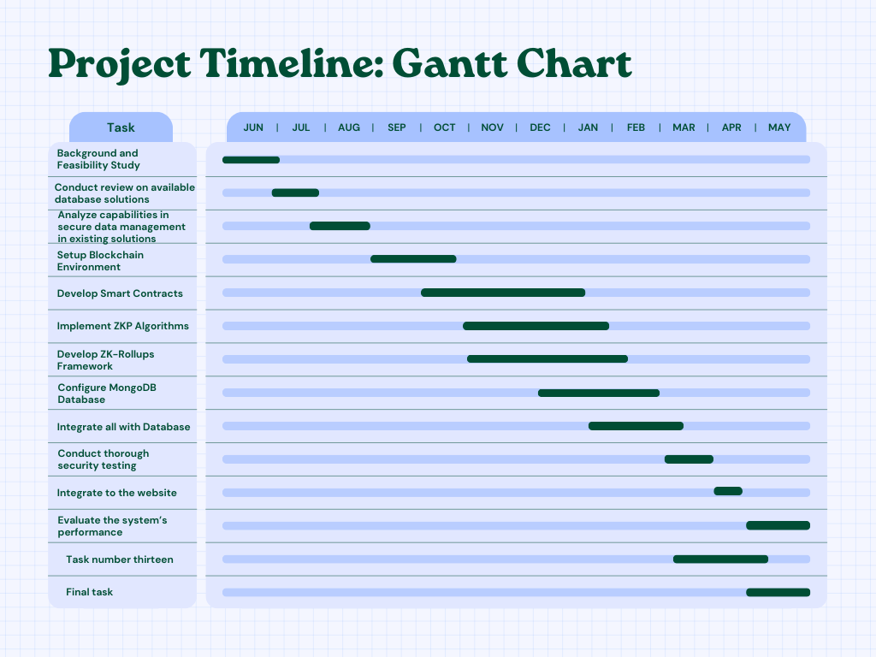
IT21015526
LANSAKARA L.H.M.J.C.
IT21171260
KUMARASIRI M.A.K.P
R24-004
R24-25J-119
02/21/2024
05/08/2024
11
PATHIRAJA P.M.C.H.
IT21352812
R24-25J-119
16
IT21015526
IT21015526
LANSAKARA L.H.M.J.C.
IT21171260
05/08/2024
27
KUMARASIRI M.A.K.P
KUMARASIRI M.A.K.P
R24-004
R24-004
R24-25J-119
02/21/2024
02/21/2024
05/08/2024
16
11
16

Slide 45
REFERENCES
[1] FANEELA, M.A. KHAN, S.A. ALSUHIBANY, W. EL-SHAFAI, M.U. REHMAN, AND J. AHMAD "AN IMMUTABLE FRAMEWORK FOR SMART HEALTHCARE USING BLOCKCHAIN TECHNOLOGY," COMPUT. SYST. SCI. ENG., VOL. 46, NO. 1, PP. 165-179. 2023. HTTPS://DOI.ORG/10.32604/CSSE.2023.035066
[2] J. WANG, W. OU, O. ALFARRAJ, A. TOLBA, G. KIM, AND Y. REN "BLOCK VERIFICATION MECHANISM BASED ON ZERO-KNOWLEDGE PROOF IN BLOCKCHAIN," COMPUT. SYST. SCI. ENG., VOL. 45, NO. 2, PP. 1805-1819. 2023. HTTPS://DOI.ORG/10.32604/CSSE.2023.029622
[3] AL-ASWAD, H., EL-MEDANY, W. M., BALAKRISHNA, C., ABABNEH, N., & CURRAN, K. (2021). BZKP: BLOCKCHAIN-BASED ZERO-KNOWLEDGE PROOF MODEL FOR ENHANCING HEALTHCARE SECURITY IN BAHRAIN IOT SMART CITIES AND COVID-19 RISK MITIGATION. ARAB JOURNAL OF BASIC AND APPLIED SCIENCES, 28(1), 154–171. HTTPS://DOI.ORG/10.1080/25765299.2020.1870812
PATHIRAJA P.M.C.H.
IT21352812
R24-25J-119
IT21015526
IT21015526
LANSAKARA L.H.M.J.C.
IT21171260
05/08/2024
29
KUMARASIRI M.A.K.P
KUMARASIRI M.A.K.P
R24-004
R24-004
R24-25J-119
02/21/2024
05/08/2024
11
02/21/2024
18
18

Slide 46
PALATHISI SANDARUWAN
IT21157646
SANDARUWAN W.U.P
SPECIALIZATION : CYBER SECURITY
DEVELOP XSS DETECTION SYSTEM FOR SAFEGUARDING THE SECURITY AND INTEGRITY OF HEALTH DATA SERVICES
SANDARUWAN W.U.P
IT21157646
R24-25J-119
06/08/2024
39

Slide 47
BACKGROUND
WHAT IS AN XSS IDENTIFICATION MACHINE LEARNING MODEL?
An XSS Identification Machine Learning Model detects XSS attacks by analyzing input patterns and script tags in real-time, trained on datasets of benign and malicious inputs, enhancing web application security by identifying and mitigating vulnerabilities.
IMPORTANCE OF IDENTIFYING XSS ATTACKS IN THE HEALTH DATA MANAGEMENT SYSTEM
Protection of Sensitive Data
Regulatory Compliance
Maintaining Trust and reputation
Preventing Data Breaches
Ensuring System Integrity
IT21182464
ARACHCHI R.P.N
IT21157646
SANDARUWAN W.U.P
R24-25J-119
IT21015526
R24-25J-119
IT21015526
IT21171260
05/08/2024
06/08/2024
31
LANSAKARA L.H.M.J.C.
39
KUMARASIRI M.A.K.P
KUMARASIRI M.A.K.P
R24-004
R24-004
R24-25J-119
02/21/2024
05/08/2024
11
02/21/2024
31
09

Slide 48
RESEARCH QUESTION​
​
HOW CAN INTEGRATING AN XSS DETECTION SYSTEM BASED ON MACHINE LEARNING INTO HEALTH DATA MANAGEMENT PLATFORMS ENHANCE SECURITY BY PROVIDING REAL-TIME IDENTIFICATION AND ANALYSIS OF USER INPUTS, THEREBY SAFEGUARDING THE INTEGRITY AND CONFIDENTIALITY OF SENSITIVE HEALTH DATA?
IT21182464
ARACHCHI R.P.N
IT21157646
SANDARUWAN W.U.P
R24-25J-119
IT21015526
R24-25J-119
IT21171260
05/08/2024
06/08/2024
32
LANSAKARA L.H.M.J.C.
39
KUMARASIRI M.A.K.P
R24-004
R24-25J-119
02/21/2024
05/08/2024
10
32

Slide 49
RESEARCH GAP
Application References | Deep Learning Model Implementation | Real-Time Analysis | Quickly Adaptive and Learning | Specialization for Health Data Management
Research A
Research B
Research C
DIGIMED
IT21182464
ARACHCHI R.P.N
IT21157646
SANDARUWAN W.U.P
R24-25J-119
IT21015526
R24-25J-119
IT21171260
05/08/2024
06/08/2024
33
LANSAKARA L.H.M.J.C.
39
KUMARASIRI M.A.K.P
R24-004
R24-25J-119
02/21/2024
05/08/2024
11
33

Slide 50
SPECIFIC AND SUB OBJECTIVES​
​
DEVELOP AN XSS DETECTION SYSTEM FOR HEALTH DATA MANAGEMENT THAT IS BASED ON MACHINE LEARNING. SAFEGUARDING THE SECURITY AND INTEGRITY OF HEALTH DATA SERVICES, AND PROVIDING PERIODIC REPORTS ON DETECTED VULNERABILITIES AND SYSTEM PERFORMANCE.
Identify Key Features for XSS Detection
Develop and Train a Machine Learning Model for XSS Detection
Integrate the Detection System with Health Data Management Infrastructure
Implement Real-Time Monitoring and Alert Mechanism for XSS Attacks
Evaluate and Optimize System Performance for Accurate XSS Detection
Generate and Distribute Periodic Reports on Detected Vulnerabilities and System Performance
IT21182464
ARACHCHI R.P.N
IT21157646
SANDARUWAN W.U.P
R24-25J-119
IT21015526
R24-25J-119
IT21015526
IT21171260
05/08/2024
06/08/2024
34
LANSAKARA L.H.M.J.C.
39
KUMARASIRI M.A.K.P
KUMARASIRI M.A.K.P
R24-004
R24-004
R24-25J-119
02/21/2024
05/08/2024
11
02/21/2024
34
12

Slide 51
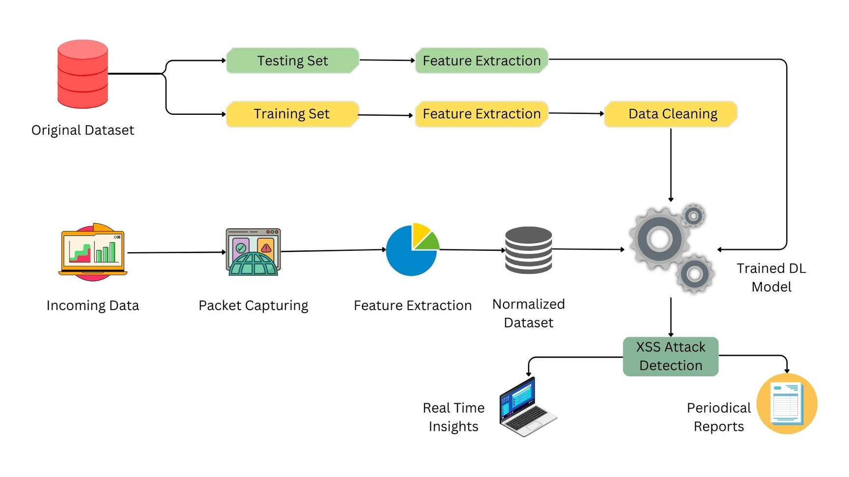
COMPONENT DIAGRAM
IT21182464
ARACHCHI R.P.N
IT21157646
SANDARUWAN W.U.P
R24-25J-119
IT21015526
R24-25J-119
IT21015526
IT21171260
05/08/2024
06/08/2024
36
LANSAKARA L.H.M.J.C.
39
KUMARASIRI M.A.K.P
KUMARASIRI M.A.K.P
R24-004
R24-004
R24-25J-119
02/21/2024
02/21/2024
05/08/2024
14
11
36

Slide 52
METHODOLOGY
DATA COLLECTION:
Review of current Xss detection methods and their limitations.
Description of datasets used for model training and validation.
Feature Engineering:
Process of selecting and extracting relevant features from network traffic.
Model selection:
Criteria for choosing the machine learning algorithm.
MODEL Training and Validation:
Deploy the model in a controlled environment.
Steps involved in training the model and validating its accuracy.
Integration and Real-Time Analysis:
Integrate the model with secure health data management system for real-time monitoring and analytics.
USE Techniques for monitoring and analyzing live traffic.
SANDARUWAN W.U.P
IT21157646
R24-25J-119
IT21015526
IT21015526
IT21171260
LANSAKARA L.H.M.J.C.
IT21182464
06/08/2024
39
ARACHCHI R.P.N
KUMARASIRI M.A.K.P
KUMARASIRI M.A.K.P
R24-004
R24-004
R24-25J-119
R24-25J-119
02/21/2024
05/08/2024
05/08/2024
11
35
02/21/2024
35
13

Slide 53
TOOLS & TECHNOLOGIES
WIRESHARK
TENSORFLOW
PYCHARM
SCIKIT-LEARN
PYTHON
MATPLOTLIB
MYSQL
JUPYTOR
GITHUB
PYTORCH
R24-25J-119
ARACHCHI R.P.N
IT21182464
R24-25J-119
05/08/2024
35
SANDARUWAN W.U.P
IT21157646
R24-25J-119
05/08/2024
07
IT21015526
IT21015526
IT21171260
LANSAKARA L.H.M.J.C.
IT21182464
06/08/2024
39
ARACHCHI R.P.N
KUMARASIRI M.A.K.P
KUMARASIRI M.A.K.P
R24-004
R24-004
R24-25J-119
R24-25J-119
02/21/2024
02/21/2024
05/08/2024
05/08/2024
13
11
35
35

Slide 54
COMPLETION OF THE PROJECT
WE ARE
HERE
Dashboard Development and Integration
Full Deployment and Evaluation
Data Collection
2024
June
2025
May
Project Planning and Preliminary Research
Model Development and Training
Pilot Testing and Refinement
Project Review and Future Planning
IT21352812
IT21182464
PATHIRAJA P.M.C.H.
IT21157646
ARACHCHI R.P.N
SANDARUWAN W.U.P
R24-25J-119
R24-25J-119
IT21015526
R24-25J-119
IT21015526
IT21171260
05/08/2024
05/08/2024
06/08/2024
39
39
LANSAKARA L.H.M.J.C.
39
KUMARASIRI M.A.K.P
KUMARASIRI M.A.K.P
R24-004
R24-004
R24-25J-119
02/21/2024
02/21/2024
05/08/2024
17
11
17

Slide 55
REQUIREMENTS
USER
FUNCTIONAL
Real-time notification of potential XSS threats.
Detailed analysis of user inputs for administrators.
Seamless integration.
High accuracy in detecting XSS attacks.
User-friendly interface
Analyze and classify user inputs in real-time.
Real-Time Notifications
Able to update and improve through continuous learning..
Provide detailed reports and analysis of detected threats.
Dashboard Development
IT21182464
ARACHCHI R.P.N
IT21157646
SANDARUWAN W.U.P
R24-25J-119
IT21015526
R24-25J-119
IT21015526
IT21171260
05/08/2024
06/08/2024
37
LANSAKARA L.H.M.J.C.
39
KUMARASIRI M.A.K.P
KUMARASIRI M.A.K.P
R24-004
R24-004
R24-25J-119
02/21/2024
02/21/2024
05/08/2024
15
11
37

Slide 56
WORK BREAKDOWN CHART
XSS Detection System
Background Study
Requirements
Documentation
Design
Implement
Testing
Topic Selection
Requirements Gathering
TAF Documentation
Wireframe Design
Data Preprocessing
Unit Testing
Feasibility Study
Requirements Analysis
Proposal Presentation
Database Design
Feature Engineering
System Testing
Literature Survey
Dashboard Design
Model Selection
Integration Testing
Requirements Specification
Proposal Report
Model Training &
Evaluation
Progress Report
Model Refinement & Deployment
Final Report
Integration with
Dashboard
IT21352812
IT21182464
PATHIRAJA P.M.C.H.
IT21157646
ARACHCHI R.P.N
SANDARUWAN W.U.P
R24-25J-119
R24-25J-119
IT21015526
R24-25J-119
IT21015526
IT21171260
05/08/2024
05/08/2024
06/08/2024
38
38
LANSAKARA L.H.M.J.C.
39
KUMARASIRI M.A.K.P
KUMARASIRI M.A.K.P
R24-004
R24-004
R24-25J-119
02/21/2024
02/21/2024
05/08/2024
16
11
16

Slide 57
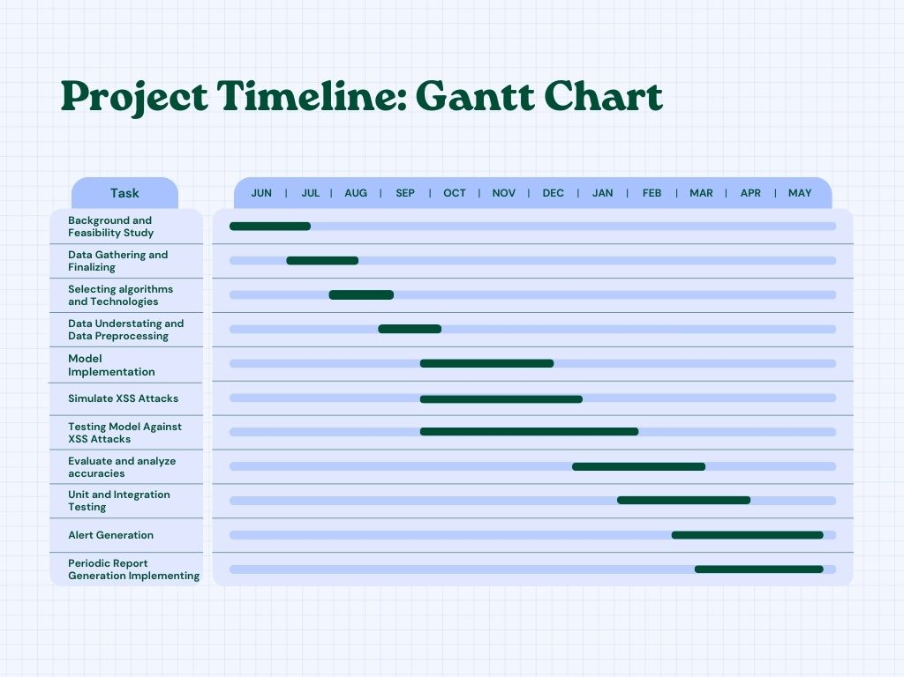
IT21015526
LANSAKARA L.H.M.J.C.
IT21171260
KUMARASIRI M.A.K.P
R24-004
R24-25J-119
02/21/2024
05/08/2024
11
IT21352812
16
IT21182464
IT21157646
IT21352812
PATHIRAJA P.M.C.H.
IT21182464
ARACHCHI R.P.N
SANDARUWAN W.U.P
R24-25J-119
R24-25J-119
IT21015526
R24-25J-119
IT21015526
IT21171260
05/08/2024
05/08/2024
06/08/2024
38
38
PATHIRAJA P.M.C.H.
39
ARACHCHI R.P.N
R24-25J-119
IT21015526
R24-25J-119
IT21015526
LANSAKARA L.H.M.J.C.
IT21171260
KUMARASIRI M.A.K.P
KUMARASIRI M.A.K.P
R24-004
R24-004
R24-25J-119
05/08/2024
05/08/2024
38
LANSAKARA L.H.M.J.C.
41
KUMARASIRI M.A.K.P
KUMARASIRI M.A.K.P
R24-004
R24-004
R24-25J-119
02/21/2024
02/21/2024
05/08/2024
16
11
02/21/2024
16
02/21/2024
05/08/2024
16
11
PATHIRAJA P.M.C.H.
IT21352812
R24-25J-119
16
IT21015526
IT21015526
LANSAKARA L.H.M.J.C.
IT21171260
05/08/2024
27
KUMARASIRI M.A.K.P
KUMARASIRI M.A.K.P
R24-004
R24-004
R24-25J-119
02/21/2024
02/21/2024
05/08/2024
16
11
16

Slide 58
REFERENCES
[1] KAUR, JASLEEN & GARG, URVASHI & BATHLA, GOURAV. (2023). DETECTION OF CROSS-SITE SCRIPTING (XSS) ATTACKS USING MACHINE LEARNING TECHNIQUES: A REVIEW. ARTIFICIAL INTELLIGENCE REVIEW. 56. 1-45. 10.1007/S10462-023-10433-3.
[2] ALSAFFAR, MOHAMMAD, SAUD ALJALOUD, BADIEA ABDULKAREM MOHAMMED, ZEYAD GHALEB AL-MEKHLAFI, TARIQ S. ALMURAYZIQ, GHARBI ALSHAMMARI, AND ABDULLAH ALSHAMMARI. 2022. "DETECTION OF WEB CROSS-SITE SCRIPTING (XSS) ATTACKS" ELECTRONICS 11, NO. 14: 2212. HTTPS://DOI.ORG/10.3390/ELECTRONICS11142212
[3] AL-ASWAD, H., EL-MEDANY, W. M., BALAKRISHNA, C., ABABNEH, N., & CURRAN, K. (2021). BZKP: BLOCKCHAIN-BASED ZERO-KNOWLEDGE PROOF MODEL FOR ENHANCING HEALTHCARE SECURITY IN BAHRAIN IOT SMART CITIES AND COVID-19 RISK MITIGATION. ARAB JOURNAL OF BASIC AND APPLIED SCIENCES, 28(1), 154–171. HTTPS://DOI.ORG/10.1080/25765299.2020.1870812
IT21352812
IT21182464
PATHIRAJA P.M.C.H.
IT21157646
ARACHCHI R.P.N
SANDARUWAN W.U.P
R24-25J-119
R24-25J-119
IT21015526
R24-25J-119
IT21015526
IT21171260
05/08/2024
05/08/2024
06/08/2024
40
40
LANSAKARA L.H.M.J.C.
39
KUMARASIRI M.A.K.P
KUMARASIRI M.A.K.P
R24-004
R24-004
R24-25J-119
02/21/2024
05/08/2024
11
02/21/2024
18
18

Slide 59

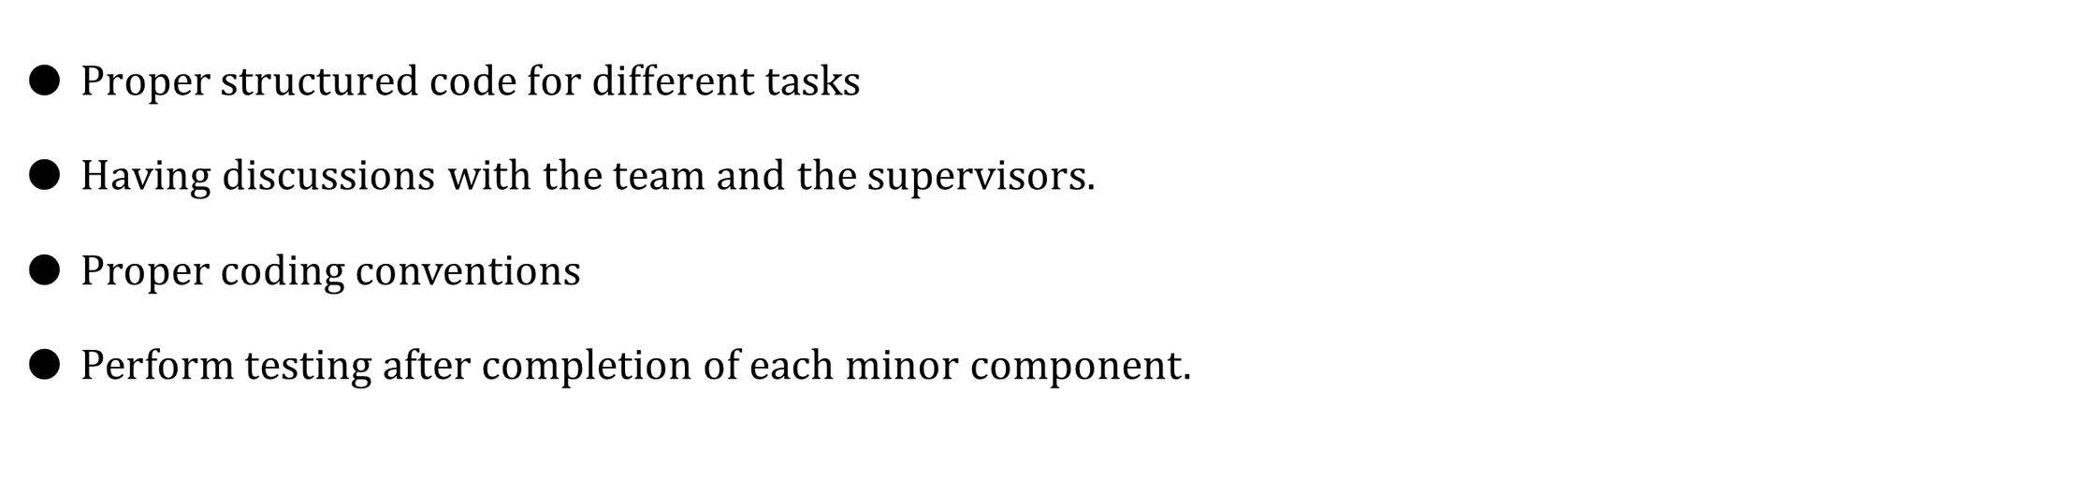
R24-25J-119
|
IT21015144
05/08/2024
02
MENDIS B.J.N.D
R24-004
02/21/2024
51

Slide 60

COMMERCIALIZATION
Market Demand: Addressing critical industry pain points in healthcare sector - data security, patient privacy, and operational inefficiencies, with a growing market for advanced data security solutions in healthcare sector.
Value Proposition:
For HealthCare Institutes: Increased data security, improved customer Satisfaction,
predictive analytics for DDoS and XSS attacks for health data using AI
For Patients: Data privacy and security, Improved healthcare services through timely and accurate
data access.
Go-to-Market Strategy:
Initial focus on large healthcare institutions and hospitals with a high need for secure data
management.
Strategic partnerships for market credibility and access.
Pilot programs to build case studies and validate ROI.
Competitive Advantage: Unique integration of secure health data management system for highly secure, comprehensive, efficient data management solution not currently available in the market.
R24-25J-119
06/08/2024
61
R24-004
02/21/2024
52

Slide 61
THANK
YOU !
R24-25J-119
06/08/2024
62

Slide 62
Q & A
R24-004
R24-004
06/08/2024
63

